Slide 1
Prefix Sums, Difference Arrays
- Srivaths P

Slide 2
Goals:
Learn about 1D prefix sums.
Learn about 2D prefix sums.
Learn about difference arrays.
Learn about various use cases of difference arrays.

Slide 3
Prefix Sums
A prefix sum stores the sum of the prefix of an array at each index. Takes O(N) time complexity to compute.
Prefix sums can be used to answer queries such as “Sum of elements of array from [L, R]” in O(1) time complexity
prefix[k] = sum of array from 0 to k

Slide 4
Implementation
for (int i = 0; i < n; i++) { prefix_sum[i] = 0; for (int j = 0; j <= i; j++) prefix_sum[i] += a[i]; }
O(N²):
O(N):
prefix_sum[0] = a[0]; for (int i = 1; i < n; i++) prefix_sum[i] = prefix_sum[i-1] + a[i];

Slide 5
Sum of range in O(1)
We can write sum from [L, R] as sum from [0, R] – sum from [0, L-1]
Which can be written as
Note: Pre-computation takes O(N)
prefix_sum[r] - prefix_sum[l-1]

Slide 6
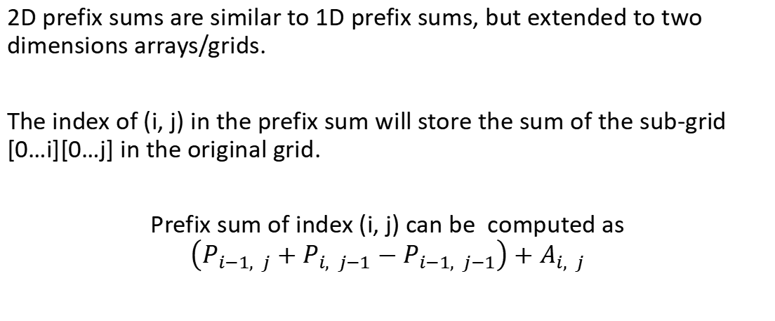
2D Prefix Sums – Computation
2D prefix sums are similar to 1D prefix sums, but extended to two dimensions arrays/grids.
The index of (i, j) in the prefix sum will store the sum of the sub-grid [0…i][0…j] in the original grid.
Prefix sum of index (i, j) can be computed as $\left(P_{i−1, j}+P_{i, j−1}−P_{i−1, j−1}\right)+$ $A_{i, j}$

Slide 7
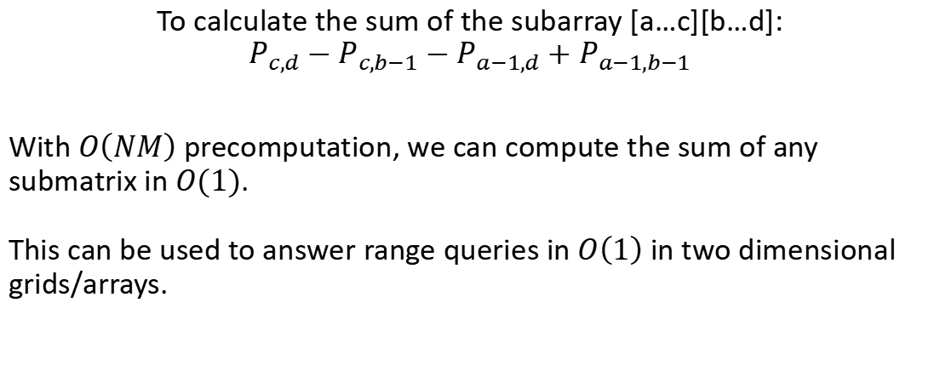
2D Prefix Sums – Range Sums
To calculate the sum of the subarray [a…c][b…d]:
$$P_{c,d}−P_{c,b−1}−P_{a−1,d}+P_{a−1,b−1}$$
With $O\left(NM\right)$ precomputation, we can compute the sum of any submatrix in $O(1)$. This can be used to answer range queries in $O\left(1\right)$ in two dimensional grids/arrays.

Slide 8
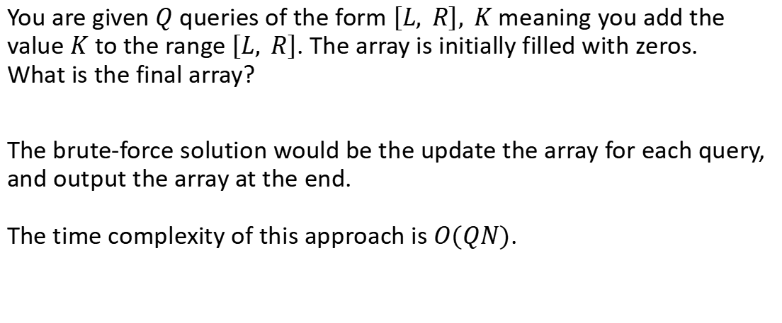
Difference Arrays
You are given $Q$ queries of the form $\left[L, R\right], K$ meaning you add the value $K$ to the range $\left[L, R\right]$. The array is initially filled with zeros. What is the final array?
The brute-force solution would be the update the array for each query, and output the array at the end. The time complexity of this approach is $O(QN)$.

Slide 9
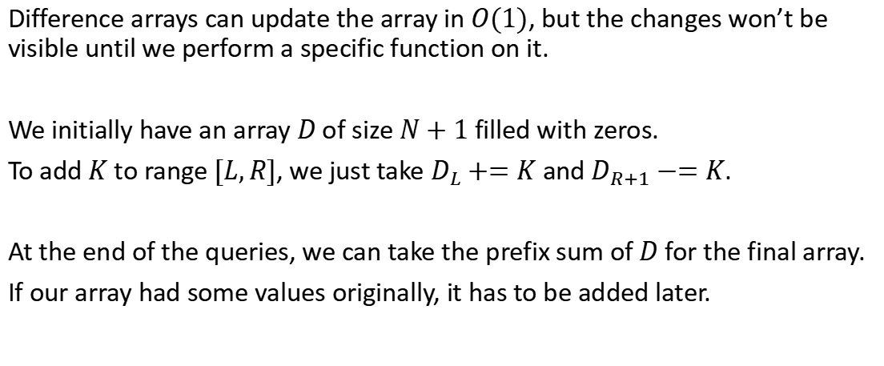
Difference Arrays
Difference arrays can update the array in $O(1)$, but the changes won’t be visible until we perform a specific function on it.
We initially have an array $D$ of size $N+1$ filled with zeros.
To add $K$ to range $[L,R]$, we just take $D_{L}+=K$ and $D_{R+1}−=K$.
At the end of the queries, we can take the prefix sum of $D$ for the final array.
If our array had some values originally, it has to be added later.

Slide 10
Feedback Form:
https://forms.gle/nhVujZdx6HqwyVfA9

Slide 11
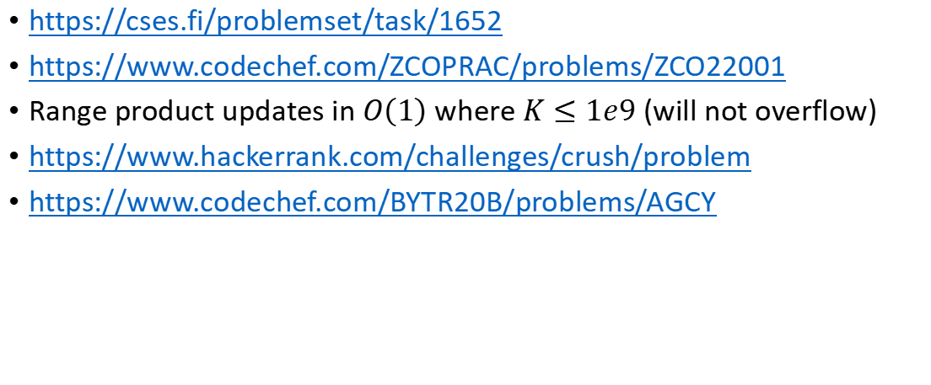
Problems to Solve:
https://cses.fi/problemset/task/1652
https://www.codechef.com/ZCOPRAC/problems/ZCO22001
Range product updates in $O\left(1\right)$ where $K≤1e9$ (will not overflow)
https://www.hackerrank.com/challenges/crush/problem
https://www.codechef.com/BYTR20B/problems/AGCY

Slide 12
Resources
https://usaco.guide/silver/more-prefix-sums?lang=cpp
https://codeforces.com/blog/entry/78762 (basic)
https://codeforces.com/blog/entry/86420 (advanced)
https://en.wikipedia.org/wiki/Modulo_operation (properties of mod)

